Slide 1
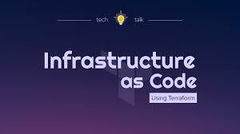

Slide 2
Agenda
Software lifecycle
DevOps lifecycle
IAC Concept
Introduction to Terraform
Summary

Slide 3
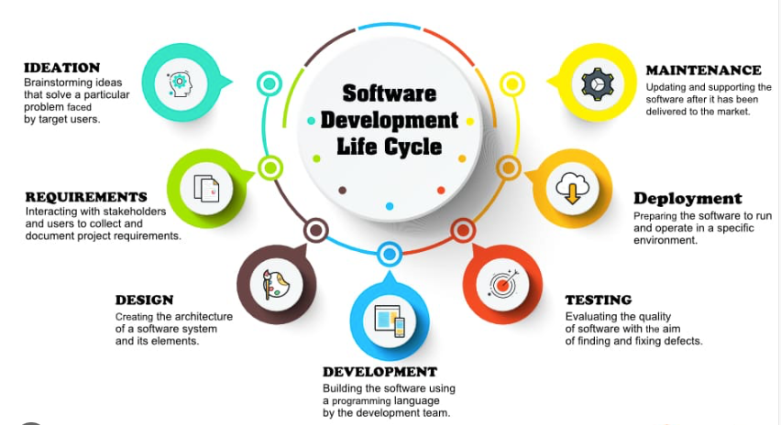

Slide 4
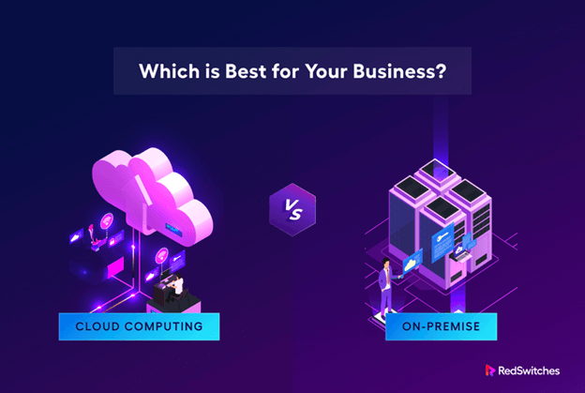

Slide 5
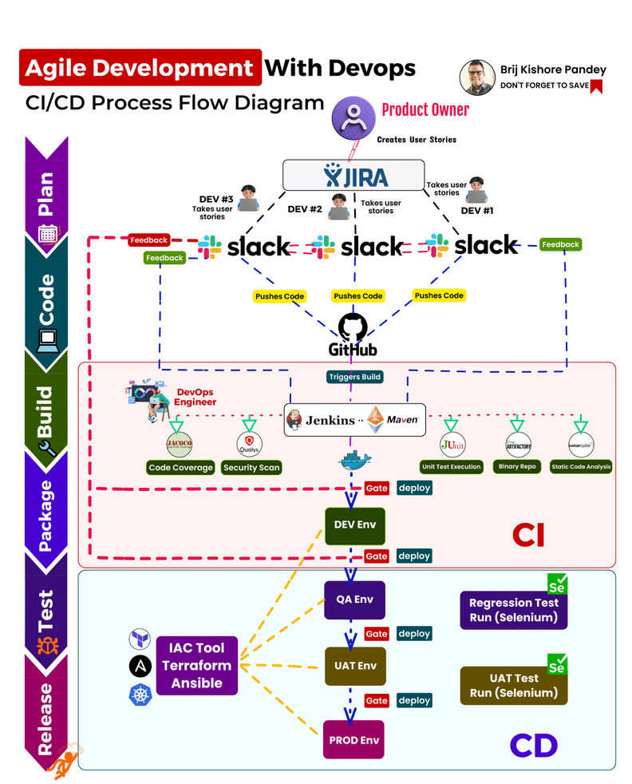

Slide 6
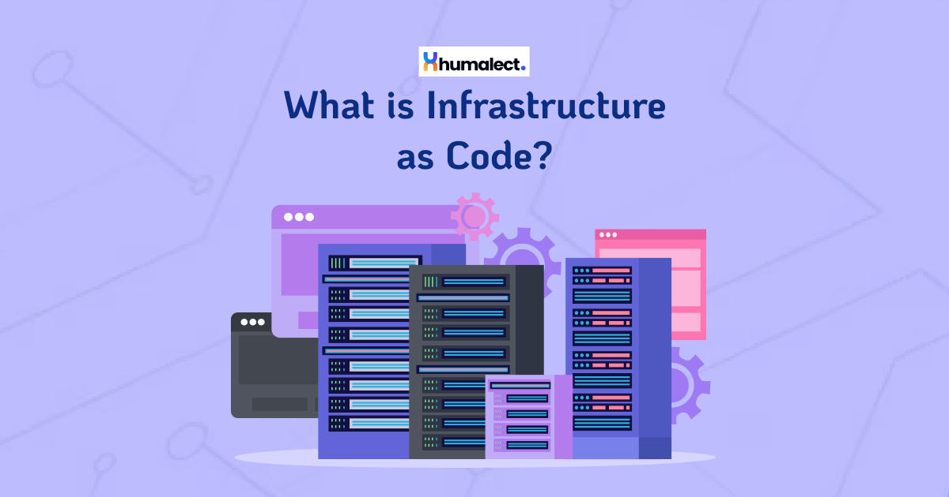

Slide 7
Infrastructure as Code
Infrastructure as Code (IaC) is a concept and practice in software engineering that involves managing and provisioning computing infrastructure (such as servers, networks, storage, and services) using machine-readable definition files rather than physical hardware configuration or interactive configuration tools
With Infrastructure as Code, developers and operations teams can define and manage infrastructure resources through code, typically using declarative configuration files. This code can be version-controlled, tested, and executed to automate the deployment and management of infrastructure components.

Slide 8
Why IAC ?
Provisioning infrastructure has historically been a time-consuming and costly manual process. As virtualization, containers, and cloud computing have become the norm, infrastructure management has moved away from physical hardware in data centers—providing many benefits, but also creating some new challenges.
With cloud computing, the number of infrastructure components has grown, more applications are being released to production on a daily basis, and infrastructure needs to be able to be spun up, scaled, and taken down frequently. Without an IaC practice in place, it becomes increasingly difficult to manage the scale of today’s infrastructure.
IaC can help your organization manage IT infrastructure needs while also improving consistency and reducing errors and manual configuration.

Slide 9
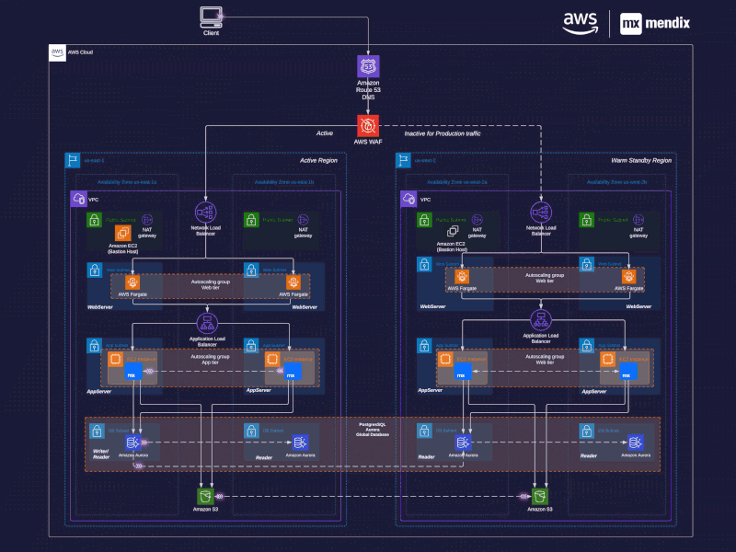
Benifts of IAC
1- Cost Reduction:
Imagine you have to
Deploy this infra again
In another region, how
much time and money
It will take ?

Slide 10

Benifts of IAC
2- Increase in speed of deployments:
Imagine you have new projects to
Work on so rather than starting from
Ground level you will just make some
Enhancement in IAC code so eventually
Will increase speed of deployment.
(Scalability,Efficiency,Reproducibility)

Slide 11

Benifts of IAC
3- Reduce human errors: when devops
And cloud engineers works individually
And independently this will lead to many
Human errors
الحمد لله عملت المشروع علي
London region
بس المفروض يكون في
Ireland region

Slide 12

Benifts of IAC
4-Consistency: Ensuring that infrastructure
deployments are consistent across different
Environments and also Facilitating collaboration
between development and operations teams.

Slide 13
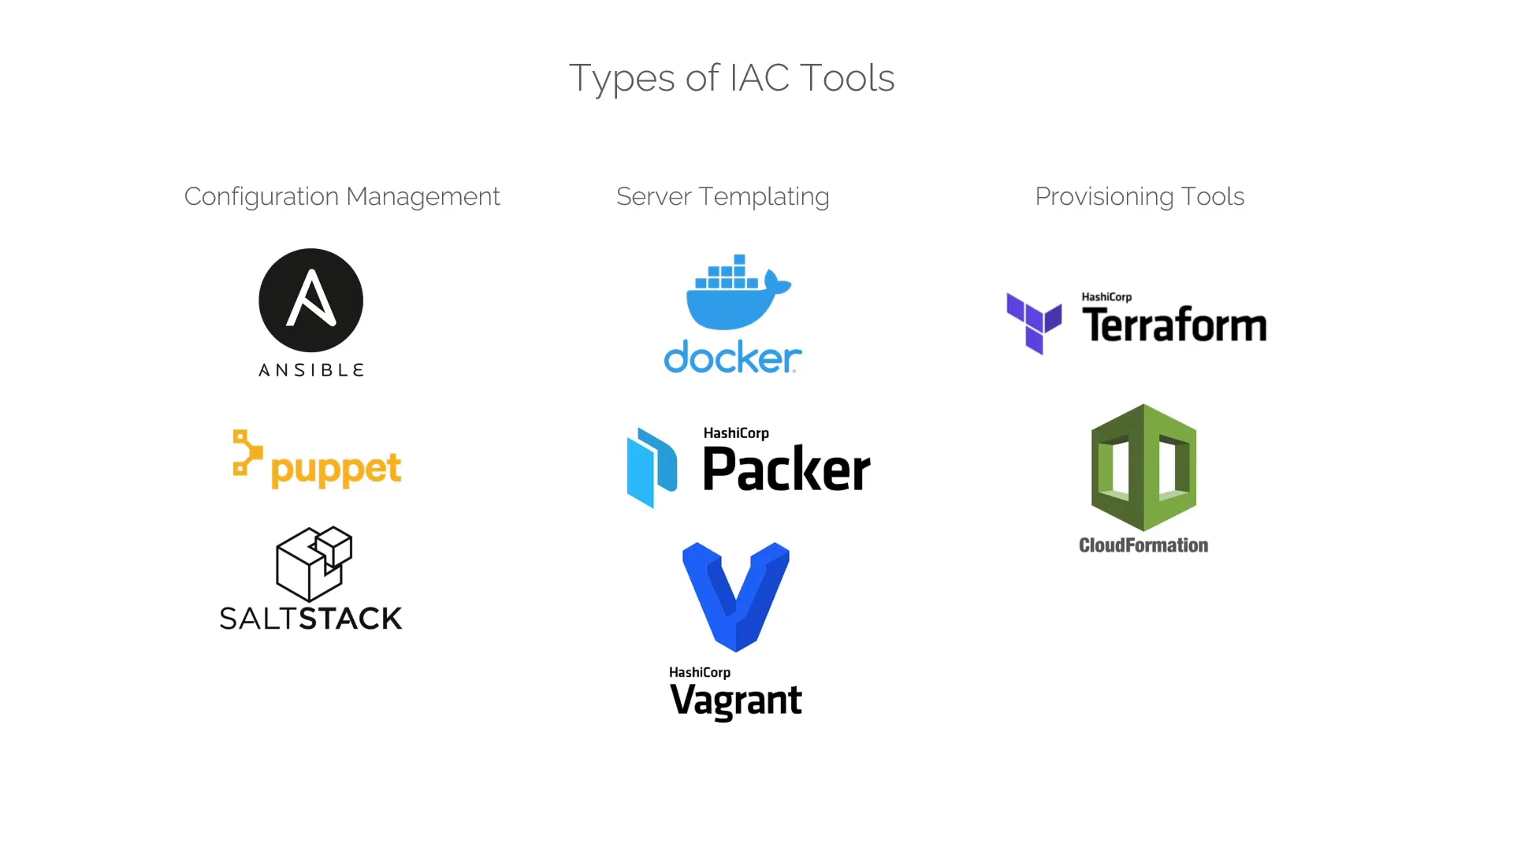

Slide 14


Slide 15
What is Terraform
Terraform is an open-source Infrastructure as Code (IaC) tool developed by HashiCorp then released on 2014 and written by go
It enables users to define and provision infrastructure resources using declarative configuration files.
Terraform allows you to manage various cloud services, as well as on-premises infrastructure, by defining the desired state of your infrastructure in code.

Slide 16
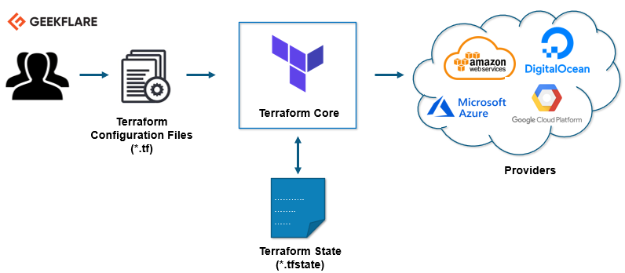

Slide 17
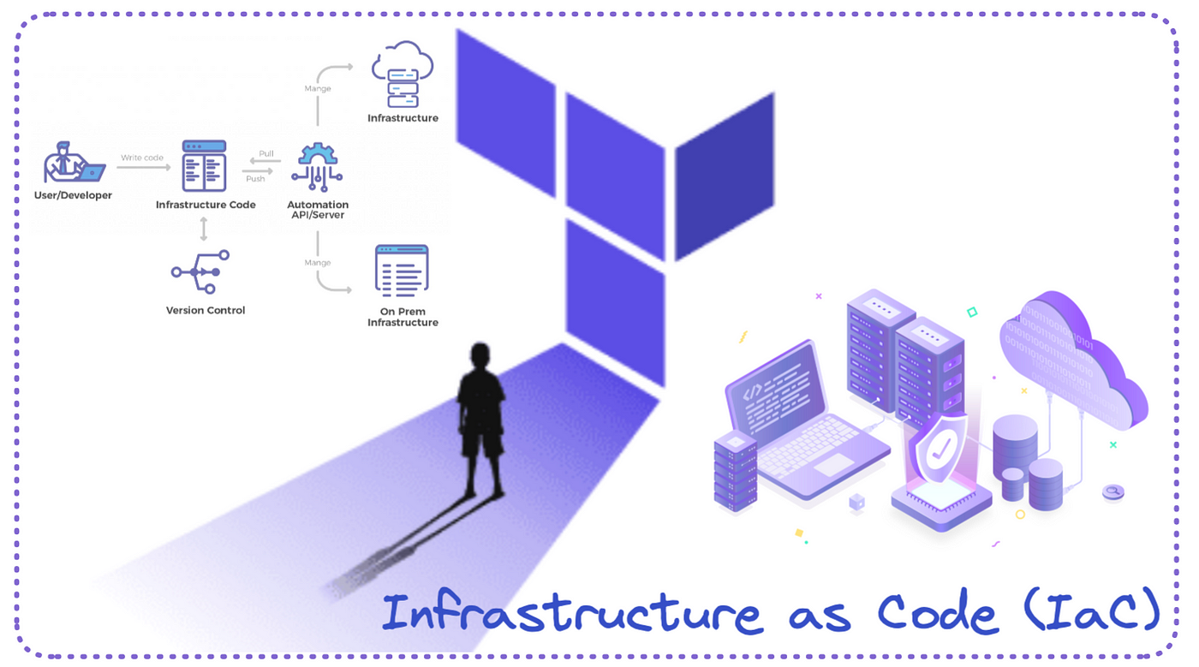
Why Terraform ?!
Free of charge
Open source
Works on any OS ( linux, windows, mac )
Very simple and well documented
Better community
Declarative Syntax
Works with multiple providers and also on prem
Agentless
State Management
Idempotnent

Slide 18
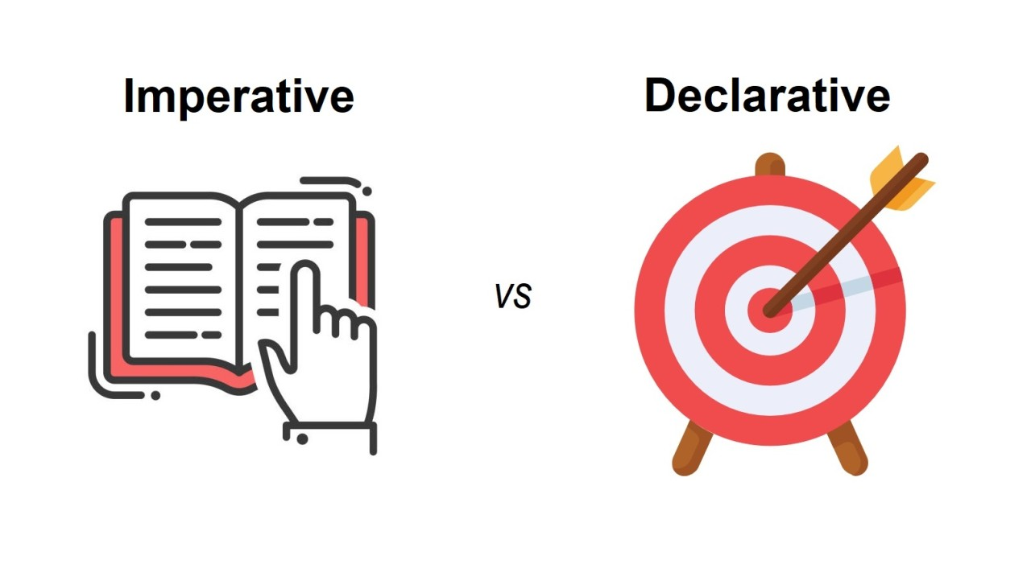

Slide 19
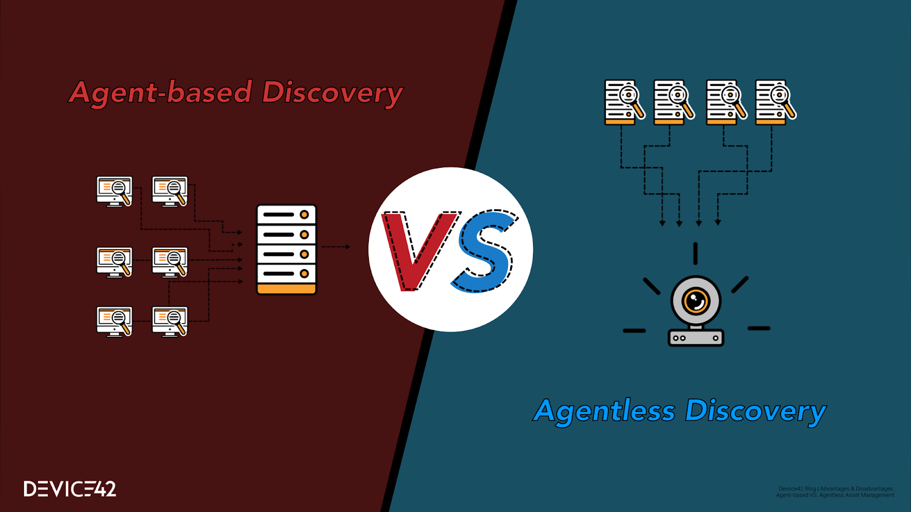

Slide 20
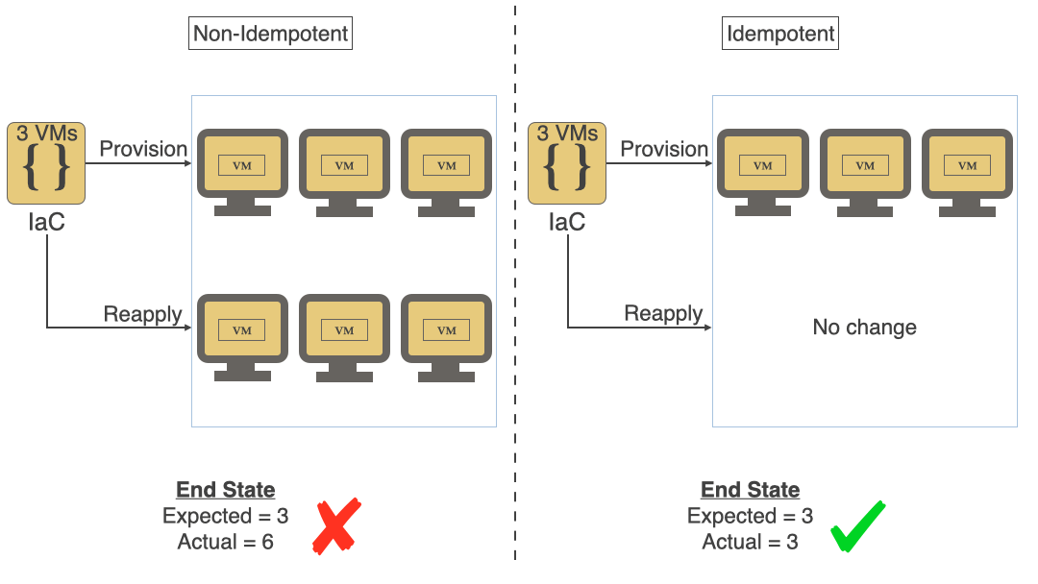

Slide 21
How terraform works ?!
Terraform is logically split into two main parts:
1- Terraform Core 2- Terraform plugins
Terraform core uses remote procedure calls (RPC) to comminicate with terraform plugins

Slide 22
Terraform core
Terraform core is a statically-compiled binary written in the go programming language.
The compiled binary is the command line tool (cli) terraform
The entrypoint for anyone using terraform
Primary responsibilities of terraform core are:
-IAC: reading, interpolating config files and modules
-Resource state management
-construction and resource graph
-plan execution
-communication with plugins over RPC

Slide 23
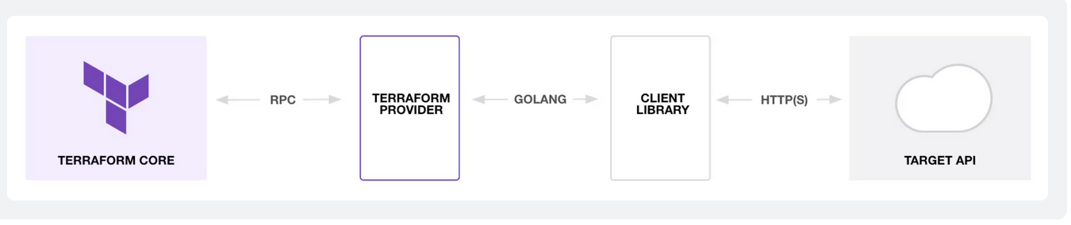
Terraform plugins
Terraform Plugins: Plugins are executable binaries written in Go that communicate with Terraform Core over an RPC interface. Terraform currently supports one type of plugin called providers. Each provider plugin exposes an implementation for a specific service or tool, such as the AWS provider or the cloud-init provider.

Slide 24
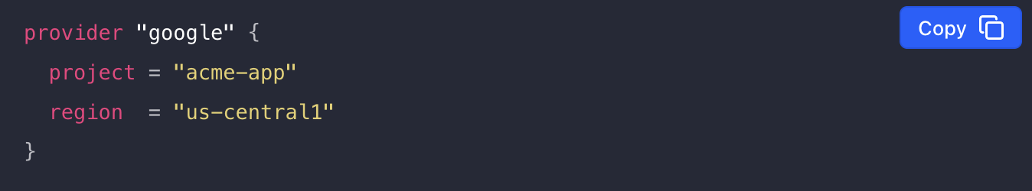
Terraform Providers
Terraform relies on plugins called providers to interact with cloud providers, SaaS providers, and other APIs.
Terraform configurations must declare which providers they require so that Terraform can install and use them. Additionally, some providers require configuration (like endpoint URLs or cloud regions) before they can be used.

Slide 25
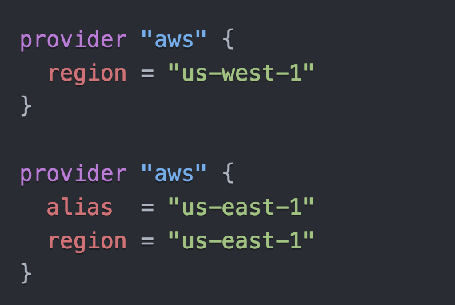
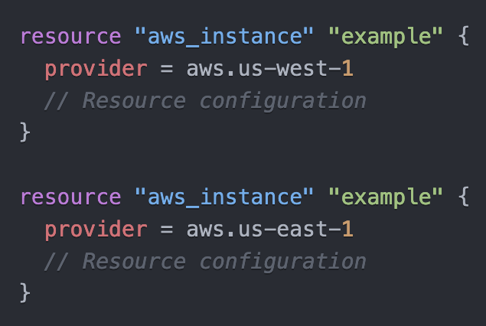
To deploy to multiple regions at same time just use alias

Slide 26
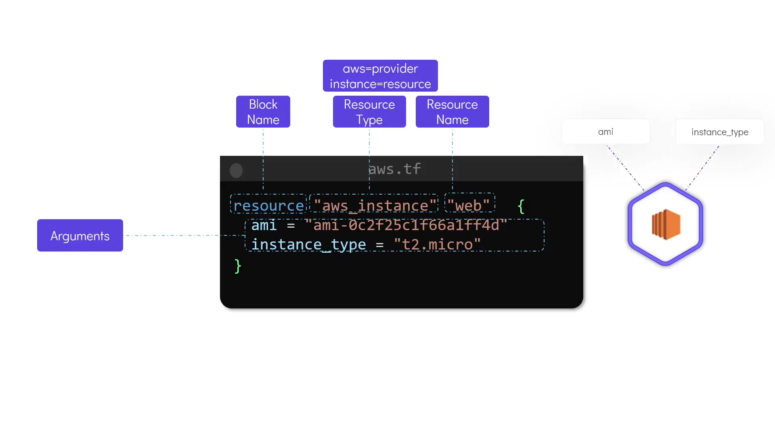
Resource Syntax

Slide 27
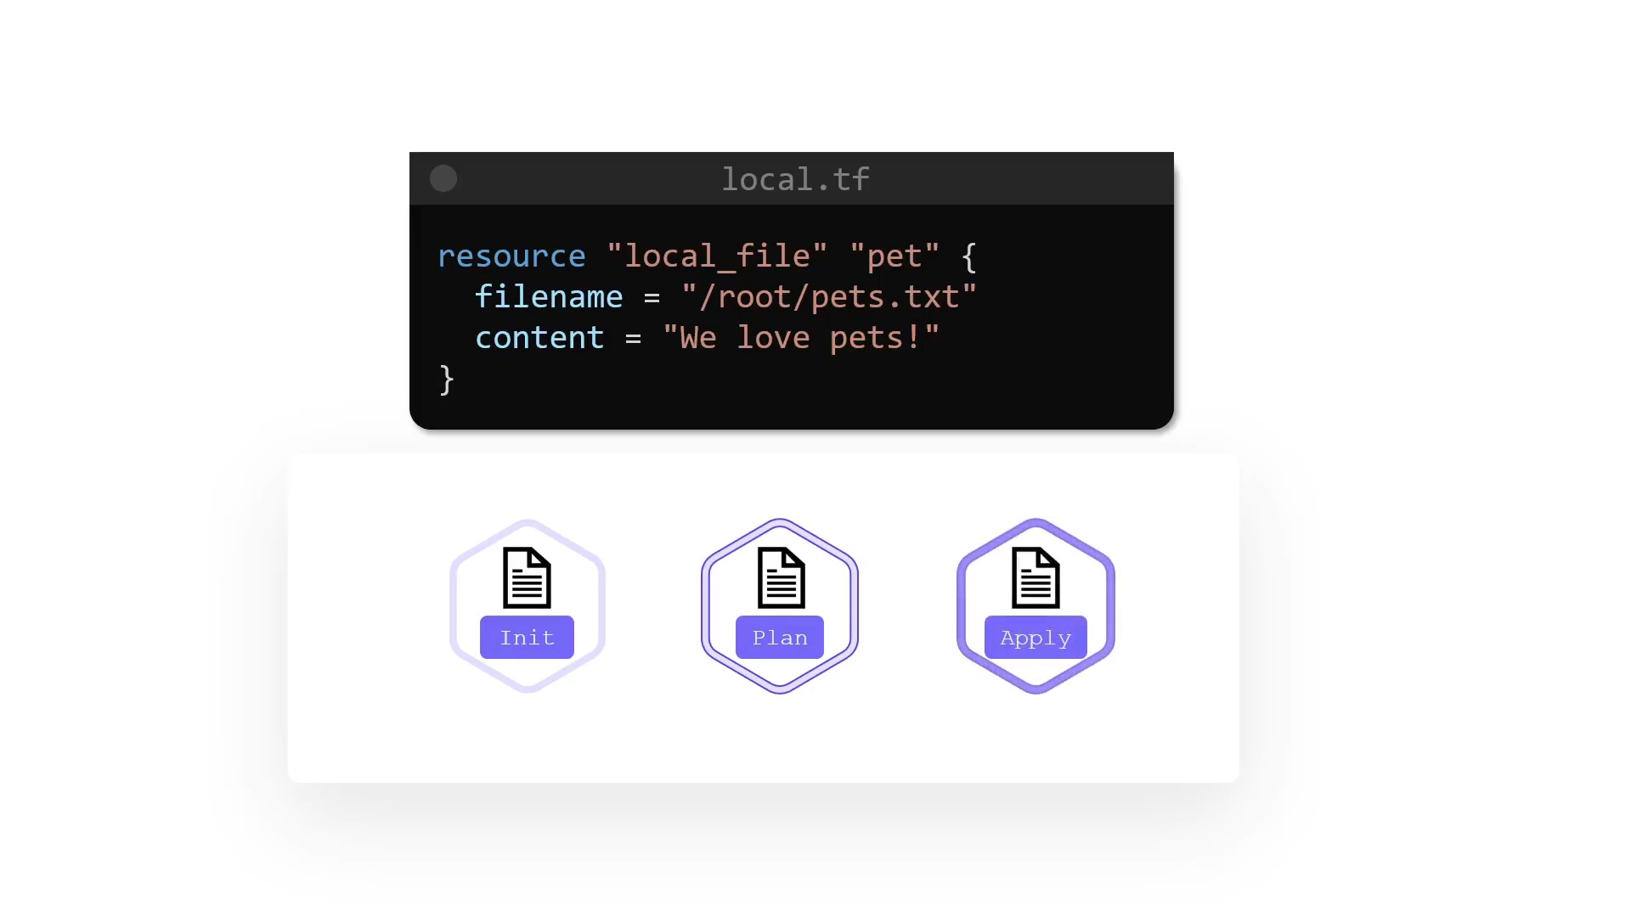
Terraform main commands

Slide 28
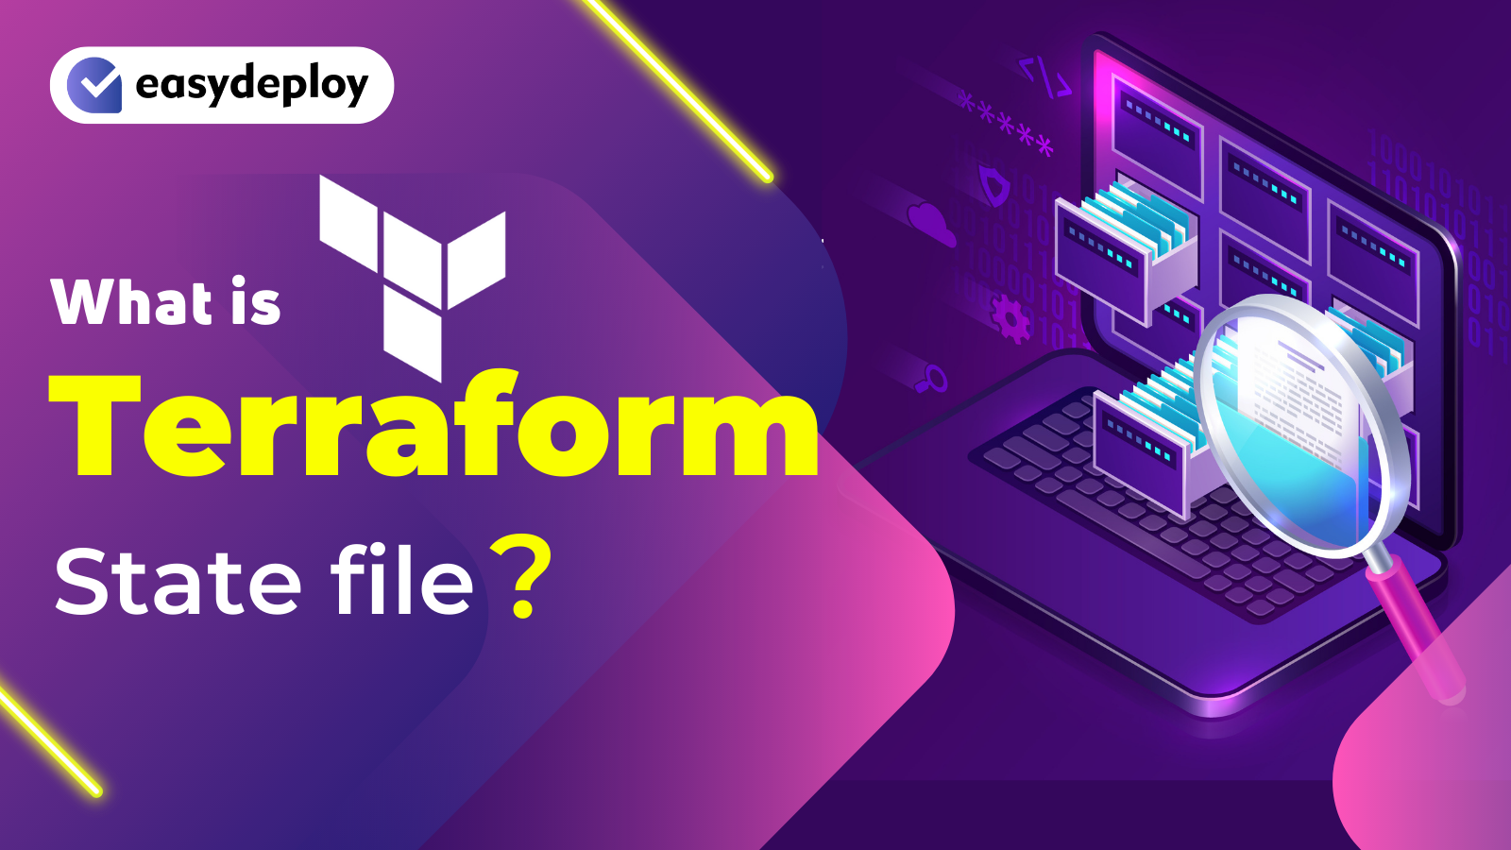

Slide 29
What is the State File in Terraform?
When you run terraform apply command to create an infrastructure on cloud, Terraform creates a state file called “terraform.tfstate”.
This State File contains full details of resources in our terraform code. When you modify something on your code and apply it on cloud, terraform will look into the state file, and compare the changes made in the code from that state file and the changes to the infrastructure based on the state file.

Slide 30
Terraform state file commands
terraform state list >> Lists all resources within the state file.
terraform state show>> Shows the attributes of a specific resource in the state
terraform state pull>> Pulls the state and outputs it to the console.
terraform state mv >> Moves an item in the state to a new address.
terraform state rm >> Removes an item from the state.
terraform state replace-provider >> Changes the provider configuration in the state.
terraform state push >> Pushes the state file to the backend.
terraform state refresh >> Updates the state file with the real-world infrastructure.
terraform state import >> Imports existing infrastructure into your Terraform state.
terraform state show >> Shows the attributes of a specific resource in the state.

Slide 31
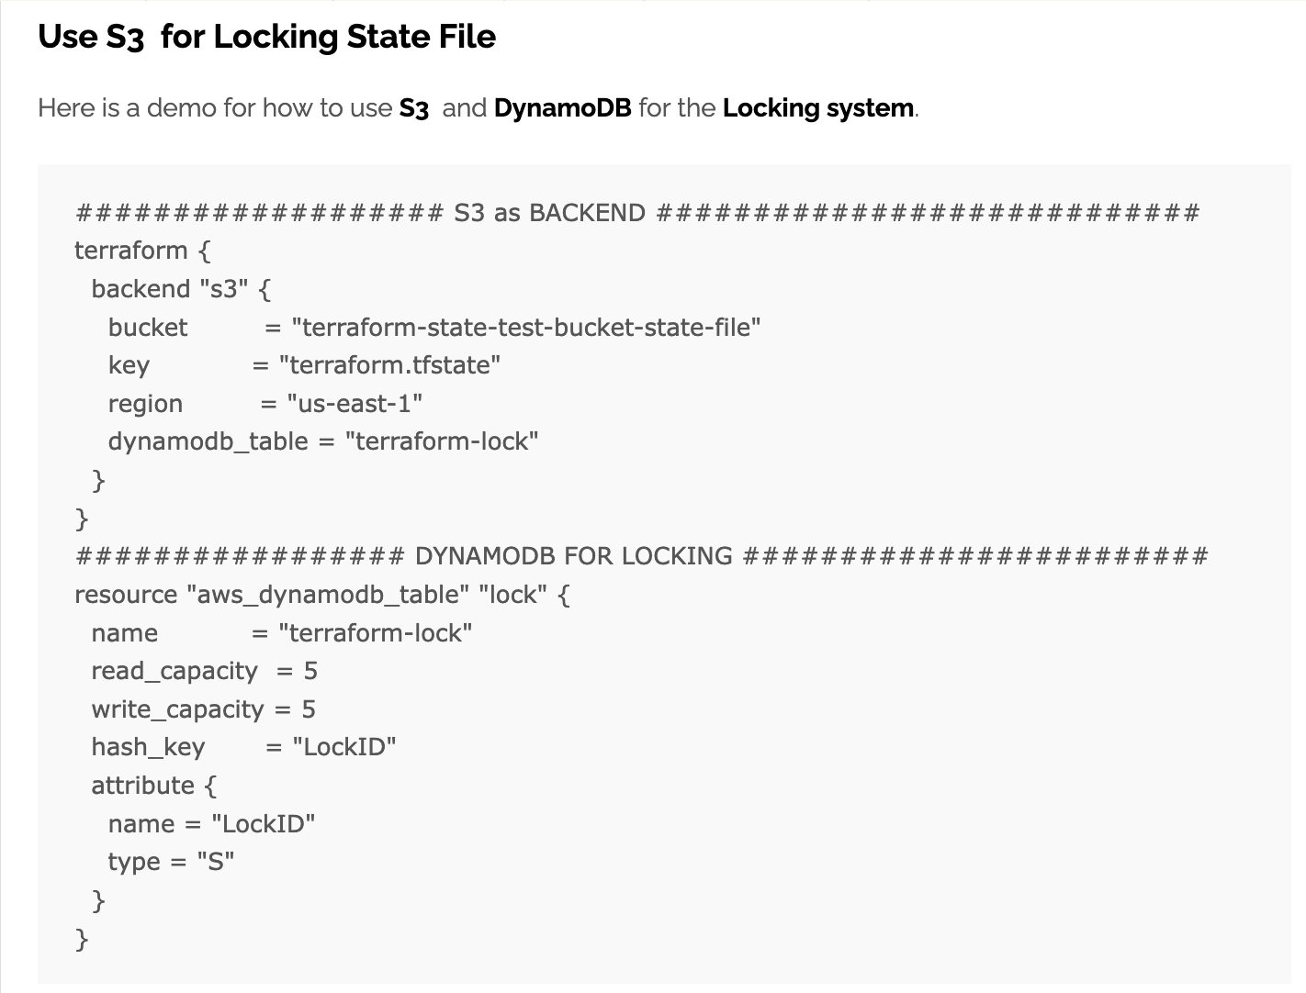

Slide 32


